Slide 1

Sharon’s Dream

Slide 2

E-learning
Internet ☺ Education
I can’t imagine a better idea than this to develop a career in Me. (Passion)
Especially when China-one of the biggest market in this world, is so vacant in online-education. (Market)
And I’m learning on it. (Skills)

Slide 3

Work Experience (Before 30)
Find a job in Hong Kong about e-learning, gain more practical experiences in it (1~5 year)
Develop your own company of e-learning
EE

Slide 4
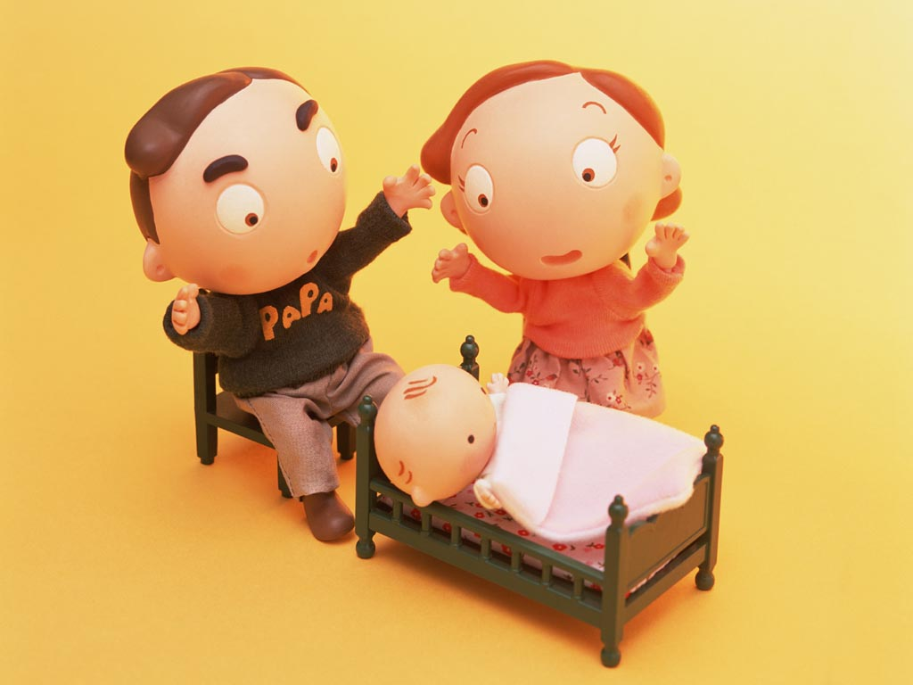

When Sharon is 30-year-old
Start her own business about e-learning
Start her own family
Start her own journey

Slide 5

When Sharon is 35-year-old
She gets her two babies in family
She travels to Australia, Japan, and America, Britain, Singapore
She is healthy, happy, slender and beautiful

Slide 6

To Be Continued…

